Slide 1
QUANTIUM RETAIL ANALYTICS

Slide 2
Agenda
Project scope & data overview
Sales and store performance insights
Product and customer analysis
RFM segmentation
A / B testing
Recommendations

Slide 3

Project scope & data overview
Solutions
The retail analytics team utilized python and SQL to analyze transaction and customer data and:
identified customer segments based on purchase behavior
Visualized data insights using matplotlib
These insights were used to make data-driven decisions related to product pricing, promotions, and targeted marketing strategies to drive category growth and increase revenue.
Problem
A category manager responsible for the chips portfolio seeks to gain a deeper understanding of the different customer segments that purchase chips and their associated purchasing behaviours.
Values
More effective pricing strategies by understanding price sensitivity across different customer segments
Targeted promotions that focus on high-value and high-frequency customers, to increase sales and revenue.

Slide 4
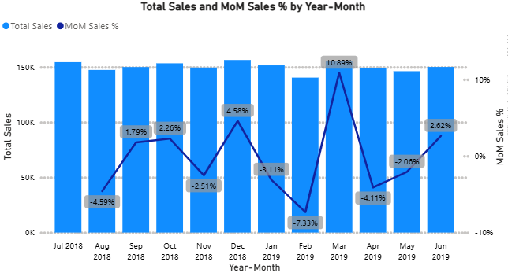
Sales and Performance Insights Overall Financial Trend
Sales remained fairly stable over the period, with the highest sale at $156,461 and an average total sale of $150k.
Month-to-month fluctuations are evident, including a temporary dip in February with a sale of $140,480 followed by a strong recovery in March, suggesting short-term volatility rather than structural decline.
The spike in December was due to Christmas period where customers shop more than their usual shopping for the festive season.
The 10.89% of MoM sales in March shows how effective the initiative or marketing strategy was, with a -7.33% in February before the initiative.
The overall financial trend shows that sales were very volatile with a temporary surge in March showing that sales are driven by short-term drivers such as promotions or seasonality.

Slide 5
Customer Purchasing Behavior Overview
Average Sales per Transaction: Approximately $7.32 per transaction
Average Quantity per Transaction: 1.91 units, equivalent to roughly 2 packs
One-Time Customers: 19,570 customers with an average spend of $6.45 per transaction
Repeat Customers: 51,717 customers with a significantly higher average spend of $32.46

Slide 6
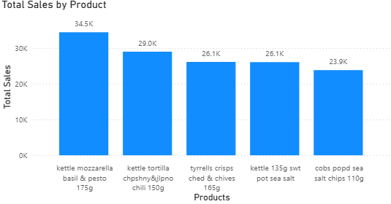
Product Analysis
Sales volumes across the top 5 products
Kettle and Cobs products are the most purchased and popular product brands among all the products with kettle showing dominant performance in sales contributing 64% of the total sales of the top 5 performing products.
Kettle mozzarella basil & pesto is the most bought chip with a total sales of $34K showing that it is the most preferred chips brand.
Henceforth stocking more Kettle brand chips increases revenue

Slide 7
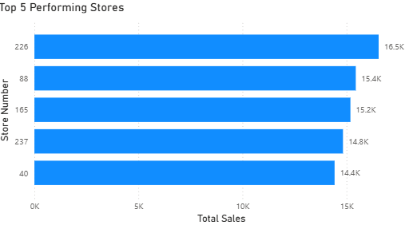
Top Performing Stores – Sales Performance Overview
Store 226 is the top contributor, with a total sale of $16.5K which is $10K more than rest of the top performing stores.
Sales across the top 5 stores fall within a relatively narrow range, with the second performing store being just $200 higher than the third performing store.
The fourth and fifth stores shows only a $400 difference in sales showing closeness in performance. This suggest stable and predictable performance.
The difference between the most performing store and the fifth performing store is $1K. Showing an incremental gap rather a drastic one.
Because the differences between stores are small, even small improvements in the mid-performing stores could significantly increase overall revenue.

Slide 8
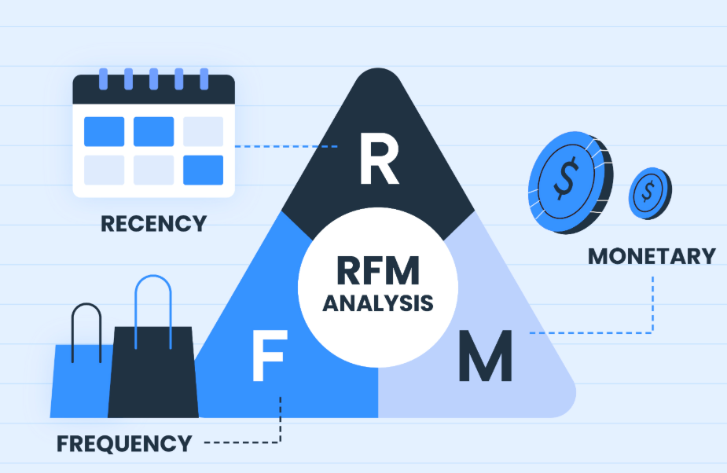
RFM Analysis
Recency (R): Measures how recently a customer made a purchase
Frequency (F): Measures how often a customer makes purchases over a given period.
Monetary (M): Measures the total value of a customer’s purchases.
Purpose: Helps segment customers based on purchasing behaviour
Applications:
Helps identify loyal customers vs at-risk customers
Drives targeted marketing campaigns
Optimize promotions and retention strategies accordingly
Outcome: RFM enables the chip store to shift from general promotions to data-driven customer targeting, increasing retention and long-term profitability.

Slide 9
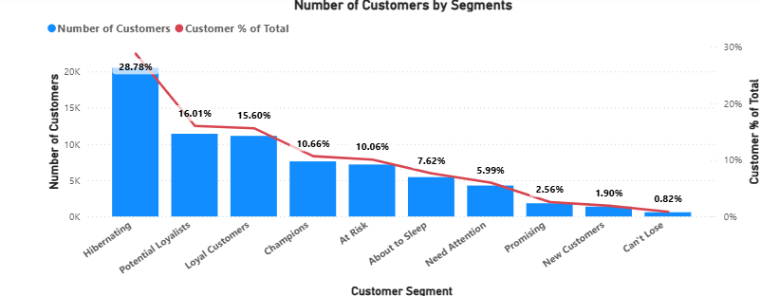
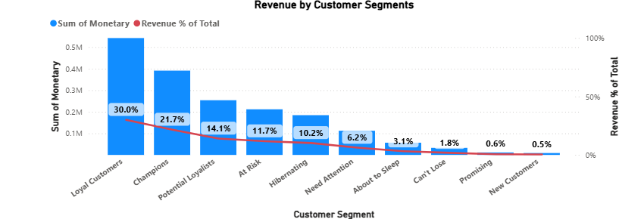
RFM Customer Behavior Analysis
Loyal Customers and Champions drive the most revenue, combining frequent purchases with high spend of over $930K that is 50% of the total revenue despite a smaller customer share
Hibernating and At-Risk segments dominate volume with almost $30K(40%) customers but show low engagement of nearly $400K(30%) in total sales, indicating high churn risk
Potential Loyalists have the third best revenue contribution of $250K(14%), which can be increased to ½ a million dollars through targeted offers and marketing strategies to encourage customers to shop more.
Promising and new customers are newly engaged and also contributes little to the total revenue of just $20K(1%), requiring onboarding and discounts on second purchases to grow loyalty.
A small group of customers generates most of the revenue, so focusing on retaining them is more valuable than only trying to attract new customers.

Slide 10
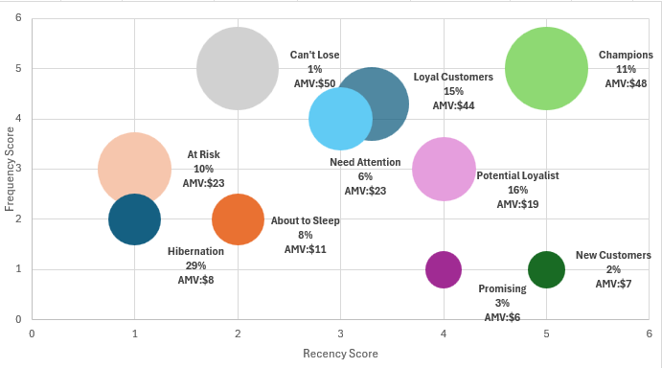
RFM Bubble Charts
Champions (11%) and Loyal Customers (15%) together make up only 26% of customers, yet they have the highest spend (AMV ~$44–$48). This means the business depends heavily on retention rather than constant new acquisition.
Hibernating (29%) and At-Risk (10%) customers represent 39% of the customer base with low spend of ($8–$23 AMV). Without intervention, a large portion of historical customers may be permanently lost.
Potential Loyalists (16%) and Need Attention (6%) — 22% of customers — are relatively recent buyers but not yet frequent purchasers. Targeted offers and reminders could realistically move many of them into the Loyal/Champion segment.
New Customers (2%) and Promising (3%) have the lowest spend ($6–$7 AMV). This suggests first-purchase experience is weak; customers are being acquired but not being kept.
Instead of focusing mainly on new customers, the biggest ROI will come from reactivation campaigns for At-Risk/Hibernating customers and loyalty rewards for Champions, improving behaviour of existing customers impacts a much larger revenue share than acquiring more low-spend buyers.

Slide 11
A/B Testing Pre-setup
Pre-setup
Clearly defined the trial setup by selecting the trial stores, setting the trial period (Feb–Apr 2019), and choosing a pre-trial period to allow a fair comparison.
Created a YEARMONTH variable so all stores could be analysed consistently at a monthly level.
Calculated key performance metrics over time, such as total sales, number of customers, transactions per customer, chips per transaction, and average price per unit.
Kept only stores with complete data(full pre-trial and trial months) before the trial to ensure accurate and reliable baseline comparisons.
Chose control stores that had enough past data before the trial to allow a fair comparison.

Slide 12

A/B Testing Store Matching Method
Compared each trial store against all eligible stores using pre-trial metrics, including total sales, number of customers, transactions per customer, chips per transaction, and average price per unit.
Assessed trend similarity using Pearson correlation, ensuring control stores exhibited similar historical patterns in sales and customer behavior to the trial stores.
Measured similarity in scale using magnitude distance, capturing absolute differences in monthly sales, customer counts, and purchasing intensity.
Standardized magnitude differences across months, reducing the impact of seasonality and extreme values on sales and transaction metrics.
Selected control stores with high correlation and low magnitude distance, ensuring alignment in both performance trends and business scale prior to the trial.
Notes:
Image source: Microsoft 365 content library A/B testing store matching involves comparing two methods for linking stores across datasets. The process helps identify the more effective approach by measuring accuracy, consistency, and match rate. Insights from the test guide improvements, ensuring reliable store identification for analytics, reporting, and targeted business strategies.

Slide 13
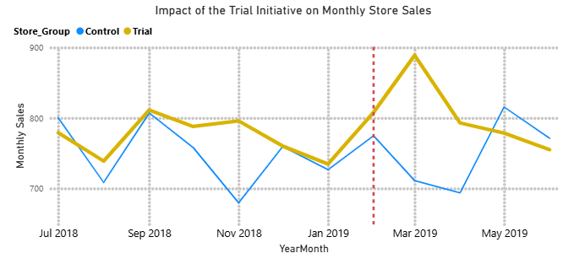
Sales Uplift Between Trial and Control Stores
The trial stores outperformed the control stores throughout the whole period.
There was a 4% sales increase in February, 25% increase in March, and 13% in April.
March recorded the highest sales uplift of about $180 increase between the trial and control store sales.
Both the control and trial stores showed the same season trend until the initiative in February.
These uplifts in sales shows that the trial initiative or strategy worked.
Notes:
Image source: Microsoft 365 content library Define clear objectives and key metrics before running an A/B test to ensure meaningful results. Segment users appropriately and ensure sample size is sufficient for statistical significance. Use a matching method, such as propensity score matching, to balance groups and minimise bias, creating accurate and reliable comparisons between variants.

Slide 14
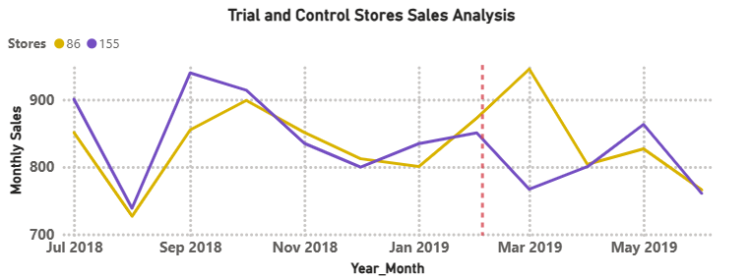
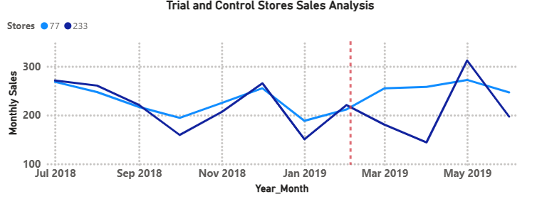
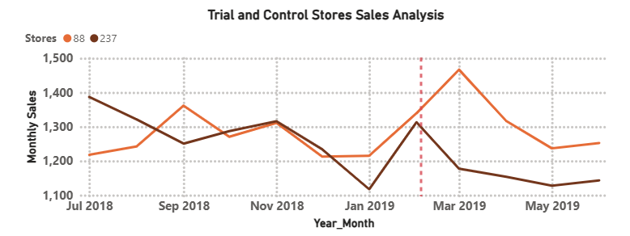
Revenue Lift Between Trial and Control Stores
Trial Stores | Control Stores
77 | 233
86 | 155
88 | 237

Slide 15
Recommendations
Convert One-Time Buyers into Repeat Customers
Identify recent but low-frequency customers (New and Promising segments) and deploy onboarding incentives such as second-purchase discounts.
Track repeat purchase uplift as a key KPI to improve customer lifetime value.
Institutionalize A/B Testing as a Decision Framework
Continue using matched control stores, pre-trial validation, and statistical testing to evaluate all major pricing, promotion, and layout changes.
Focus decision-making on measurable incremental uplift, not raw sales growth, to ensure causality and ROI.
.
Optimize Product Pricing and Bundling in High-Value Stores
Leverage insights from average price per unit and chips per transaction to test bundles (e.g. multi-pack discounts) in high-performing stores.
Focus on increasing basket size rather than aggressive price cuts to protect margins.
Activate RFM-Based Targeted Promotions
Prioritize Champions and Potential Loyalists with loyalty rewards and personalized offers to protect and grow high-value revenue.
Run reactivation campaigns for At-Risk and Hibernating customers using limited-time discounts and reminder messaging.
Notes:
Image source: Microsoft 365 content library A/B testing compares two versions of a web page or product to determine which performs better. It involves dividing users randomly into groups, each experiencing different variants. This method helps businesses make data-driven decisions by analysing user behaviour, leading to improved user engagement and increased conversion rates.

Slide 16
Thank you
Cyril Obeng-Darko
+447389170658
cyrilobeng7@gmail.com

